Slide 1
Taxi Service Trajectory in Portugal
By
Ryan D’souza

Slide 2
Relevancy + Interesting
What time of day do most people need taxis?
Indicate the number of people relying on them
After a night out
To get around in the middle of the day
Indicates parking problems
What is the best way to get a taxi
Helpful for taxi drivers and companies looking to optimize revenue
Helpful for clients to find the quickest taxi

Slide 3
Data Information
Source:
http://archive.ics.uci.edu/ml/datasets/Taxi+Service+Trajectory+-+Prediction+Challenge%2C+ECML+PKDD+2015

Slide 4
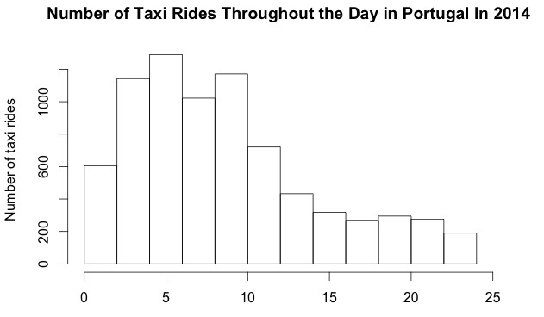
Frequency of Hailing Times for Taxis Per Day

Slide 5
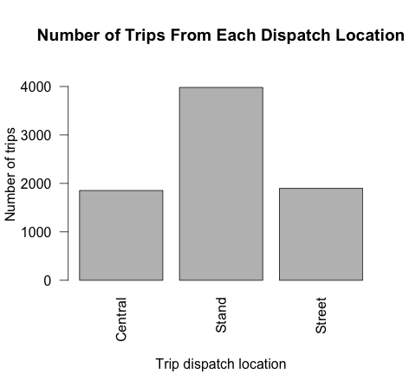
Frequency of Various Dispatch Locations

Slide 6
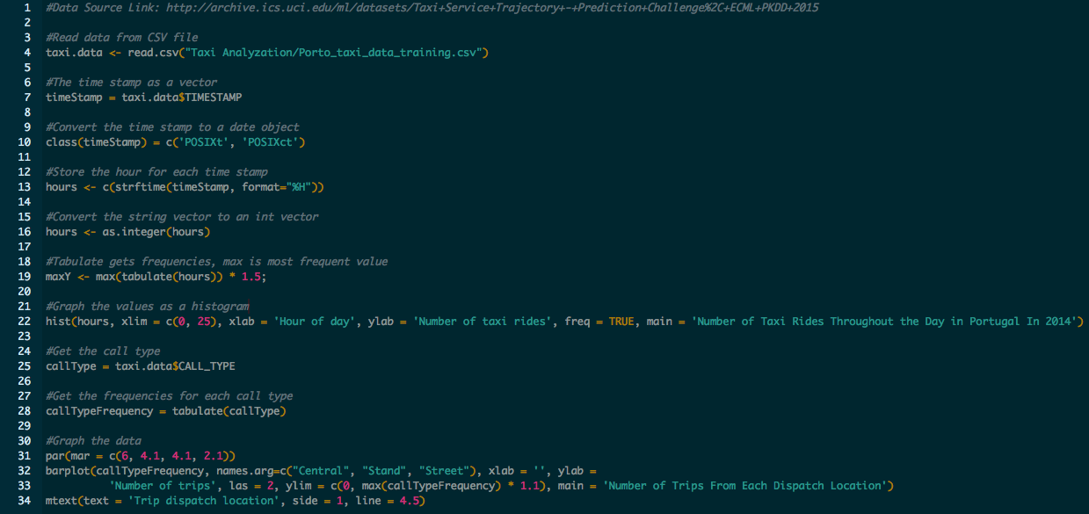
Source Code

Slide 7
Future Analysis
Any correlation between returning customers (by phone numbers) and taxi drivers
Trip length
By customer → who takes the longest journeys
By location → which drivers in which spots have to drive the most
By call location → where are long-term drivers dispatched from

